Slide 1


Introduction to Ext JS
An overview of the ExtJS
JavaScript Framework
Notes:
http://www.techferry.com/articles/ExtJS-vs-AngularJS.html

Slide 2
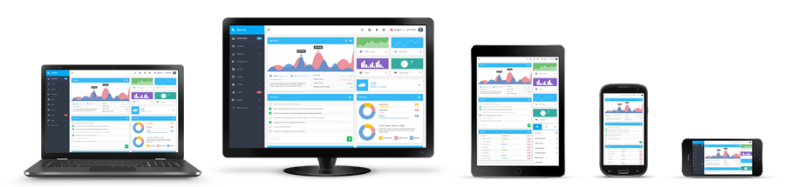
www.sencha.com
Rapidly design, develop, and manage cross-platform web applications
Notes:
Sencha since 2007
Ext JS History:
Ext JS is a client-side, JavaScript framework for building web applications. In early 2006, Jack Slocum (jackslocum.com) started working on a set of extension utilities for the Yahoo User Interface (YUI) library under the name "yui-ext." Eventually, Jack created an adapter layer through which any foundation library could be plugged in to provide utilities such as event handling, DOM manipulation and animated effects. This unanchored the library from YUI, and allowed the use of YUI, jQuery, prototype, or a new ext-base foundation written by Jack. This was version 1 of Ext JS. Current version of Ext JS is 4.2.x.
IDE:
You can use any IDE for Sencha development as per your convenient eg. Webstorm, Aptana, Eclipse, VisualStudio etc.
IDE should satisfy following requirements for the development:
It should be able to validate JavaScript code for errors and warnings
It should have autoComplete functionality for ExtJS 4 library classes and functions.
It should be able to format JavaScript code easily to make Ext JS code readable.

Slide 3
2015 Ext JS Growth Statistics
10K
60%
10K Customers worldwide
60%
Of fortune 100 companies
2M
Sencha devs wordwide
7.2M
Product download
500K
Active forum members
Customers worldwide
Of fortune 100 companies
2M

Slide 4

What is Ext JS?
A pure JavaScript application Framework for building interactive web applications.
Developed and Supported Sencha Inc
Using techniques such as Ajax, DHTML and DOM scripting
Started as extension to Yahoo's YUI
Notes:
Ext JS History:
Ext JS is a client-side, JavaScript framework for building web applications. In early 2006, Jack Slocum (jackslocum.com) started working on a set of extension utilities for the Yahoo User Interface (YUI) library under the name "yui-ext." Eventually, Jack created an adapter layer through which any foundation library could be plugged in to provide utilities such as event handling, DOM manipulation and animated effects. This unanchored the library from YUI, and allowed the use of YUI, jQuery, prototype, or a new ext-base foundation written by Jack. This was version 1 of Ext JS. Current version of Ext JS is 4.2.x.
IDE:
http://docs.sencha.com/extjs/6.0/tools/jetbrains_ide_plugin.html
You can use any IDE for Sencha development as per your convenient eg. Webstorm, Aptana, Eclipse, VisualStudio etc.
IDE should satisfy following requirements for the development:
It should be able to validate JavaScript code for errors and warnings
It should have autoComplete functionality for ExtJS 4 library classes and functions.
It should be able to format JavaScript code easily to make Ext JS code readable.

Slide 5
Why Ext JS?
Rich, Modern UI Widgets (more than 150 user interface components)
Fast to develop
Mature library
Extensible, object-oriented architecture
MVC, MVVM support
Good documentation and community support (over 1000 docs APIs)
Cross Browser Support
Notes:
ExtJS 4.0 was released around April 2011
Ext JS 5.0 was released on June 2, 2014 : using a single code base, a Model View ViewModel (MVVM) architecture, two-way data binding, responsive layouts, and other component upgrades with support for adding widgets inside a grid cell for data visualization and big data analytics
ExtJS 5.1.0 / November 2014

Slide 6
What's New in Ext JS 5
EXT JS 5
Crip theme
Routing
New MVVM AA
Widget and Widget Column
Tablet support
Two-way data-binding
Notes:
http://www.sencha.com/blog/are-you-ready-for-ext-js-5/

Slide 7





Support major browser
IE 8+, IE 10+ / Win8
Chrome Android 4.1+
Opera 12+ (PC & Mac)
Firefox 12 + (PC & Mac)
Safari 6+
10K
60%
Customers worldwide
Of fortune 100 companies
2M
Notes:
IE: 11
Mozilla Firefox: 3.8
Safari: 8
Google Chrome: 43
Opera: 30
Note: Ext JS 5 does not currently support mobile phones

Slide 8
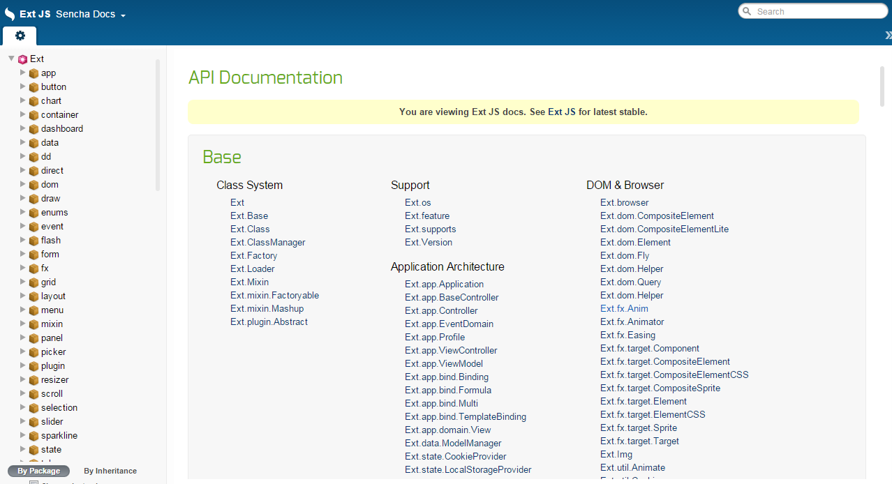
Ext JS Sencha Docs
Notes:
https://docs.sencha.com/extjs/5.1/
https://docs.sencha.com/extjs/5.1/5.1.1-apidocs/#!/api

Slide 9
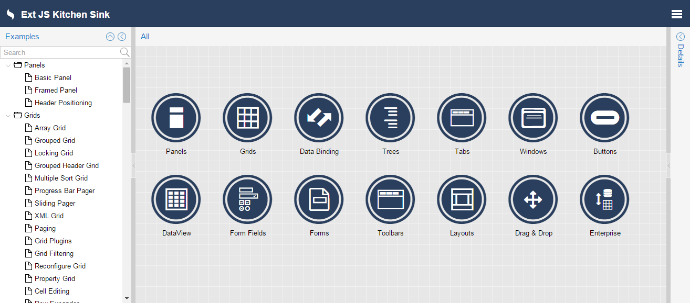
Ext JS Components & Features
Notes:
http://dev.sencha.com/ext/5.0.1/examples/kitchensink/#all

Slide 10
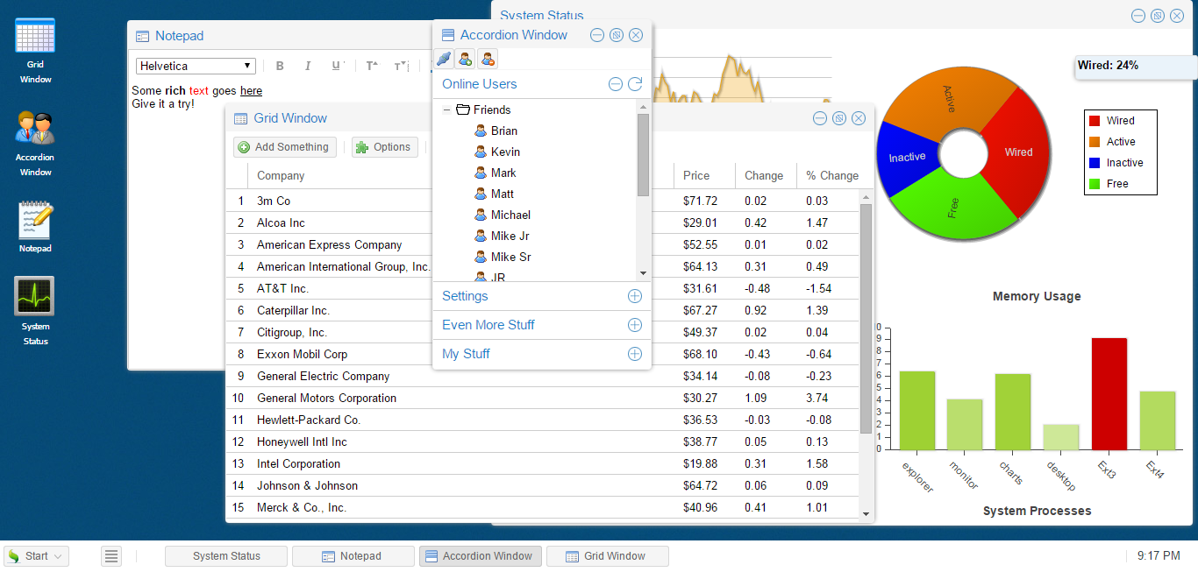
Ext JS Components & Features
Notes:
http://dev.sencha.com/ext/5.0.1/examples/desktop/index.html

Slide 11
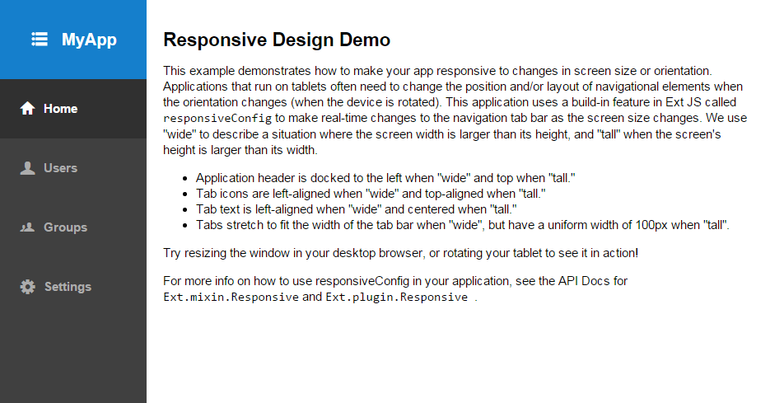
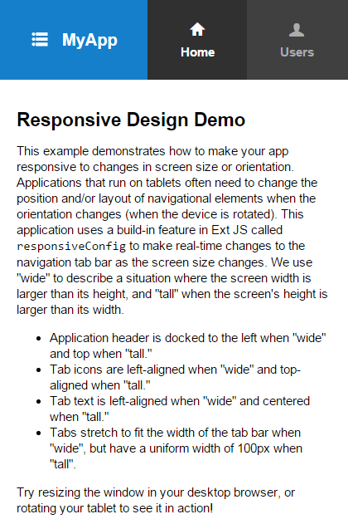
Ext JS Responsive Design

Slide 12
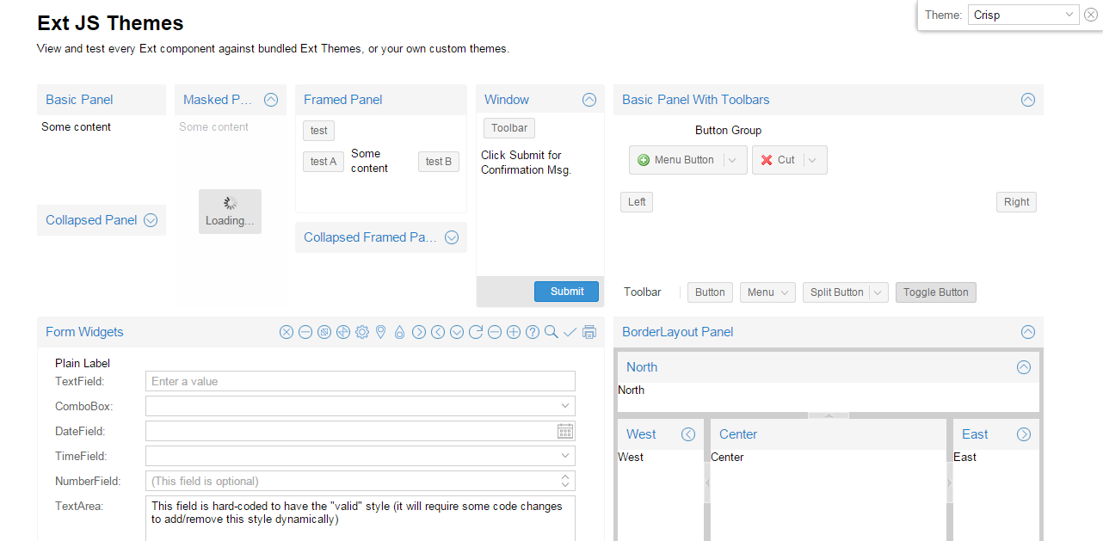
Ext JS Themes
Notes:
http://dev.sencha.com/ext/5.1.0/examples/themes/index.html

Slide 13
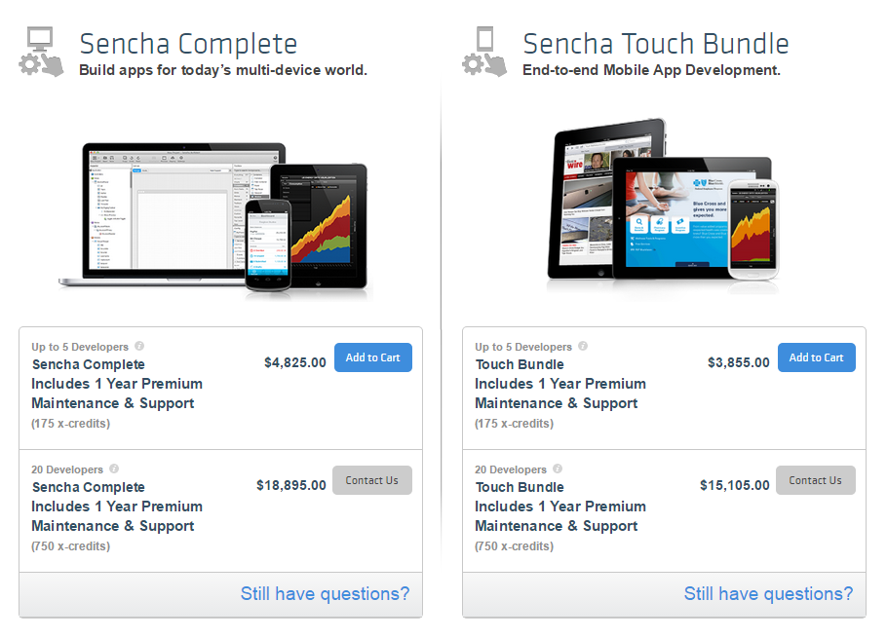
Sencha Licensing - Commercial License
Notes:
https://www.sencha.com/store/

Slide 14
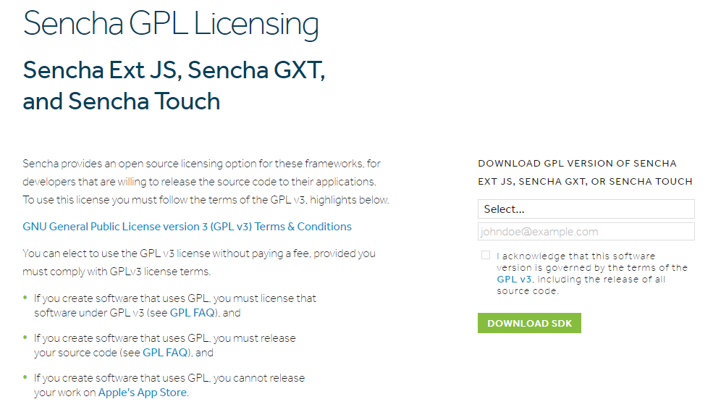
Sencha Licensing – GPL Licensing
Notes:
GPL: http://www.sencha.com/legal/

Slide 15
How do we begin?
Download GPL version of Sencha Ext JS 5.1 library(Download and Install Sencha Cmd)
Unzip using any file compression utility
from your webserver root directory: $sencha -sdk /path/to/ExtSDK generate app AppName ./DirApp
Now navigate to http://localhost:1841 or your native localhost
Notes:
License(s):
GNU General Public License v3.0
E:\Software Center\Framework\ext-5.1.0
Files and Directories in the Architect Project Tree
https://docs.sencha.com/architect/3/reference/files_directories.html
Installing Sencha Ext JS
Sencha Ext JS is a desktop application development platform with cross-browser compatibility, MVC architecture, charting, and UI widgets.
Installing Sencha Touch
Sencha Touch is a mobile application development platform with over 50 built-in components, themes for every popular mobile platform, and a built-in MVC system. Sencha Touch in the Complete package provides access to TouchGrid and Action Message Format (AMF).
a. Create the starting file structure by changing directory: sencha generate app MyApp ../MyApp
You cannot include Sencha Ext JS or Sencha GXT in a closed source distribution under this license.

Slide 16
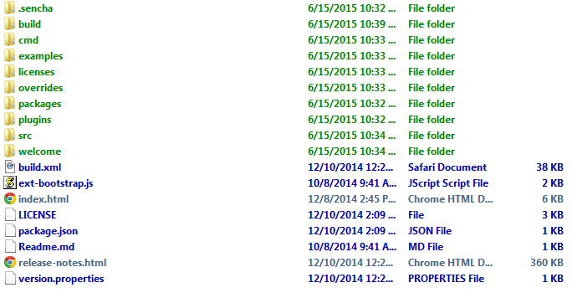
Files and Directories in the Architect Project Tree
Notes:
myapp1/
myapp1.xds # File used as entry point to saved project
.architect # User settings for your project such as nodes in Inspector
index.html # HTML index file
app/
controller/ # .js files for components in Controllers node
override/ # Optional folder that contains override files
form/
override/ # Optional folder that contains override files
model/ # .js files for components in Models node
override/ # Optional folder that contains override files
Readme.md
store/ # .js files for components in Stores node
override/ # Optional folder that contains override files
view/ # .js files for components in Views node
override/ # Optional folder that contains override files
app.js # Launches the Application class
app.json # Application decriptor
README.md
bootstrap.css
bootstrap.js
bootstrap.json
build/ # Folder where build output is placed
build.xml # Defines the app build process
ext/ # Copy of the Ext JS SDK (Ext JS projects only)
index.html # Entry point to your application
metadata/ # Files that describe the pieces of the project
Application # Metadata for the Application node
model/ # Metadata for components in the Models node
resource/ # Metadata for components in the Resources node
store/ # Metadata for components in the Stores node
view/ # Metadata for components in the Views node
overrides/
packager.json # Configuration for native packaging (Touch only)
packages/ # Sencha cmd packages
resources # Library file plus project files developed outside Sencha Architect
project-images/ # (optional) Contains images to use for styling the app
sass/
.sencha/
theme/ # Custom Themes and Themes applied from Toolbox (Ext JS only)
touch/ # Touch libraries (Touch projects only)

Slide 17
Other Sencha Products
Sencha Touch: Framework for building mobile application
Sencha.io: Cloud services for mobile
Ext Designer: Wysiwig tool for ExtJS
Sencha Animation: Tool for designing CSS3 animations
Ext GWT: Ext controls available for Google Web Toolkit
Notes:
Sencha Platform for Web Application Lifecycle Management
Sencha Ext JS
Sencha Ext JS is a desktop application development platform with cross-browser compatibility, MVC architecture, charting, and UI widgets.
Sencha Touch is a mobile application development platform with over 50 built-in components, themes for every popular mobile platform, and a built-in MVC system. Sencha Touch in the Complete package provides access to TouchGrid and Action Message Format (AMF).
Design
The Sencha platform helps you accelerate your web application development efforts with out-of-the box theming capabilities across all applications. We can help teams:
Design visually compelling web applications using pre-built and pre-tested components.
Improve agility and the overall design process with tools that make it faster and easier to mock up, style, prototype, and evaluate interface designs.
Enhance collaboration between line-of-business and IT teams to move apps quickly to the development phase.
Develop
The Sencha platform offers powerful JavaScript and Java frameworks to help developers do their best work. We can help teams:
Build better applications faster with an enterprise-ready framework.
Improve development efficiency by automatically handling critical issues such as rendering and cross-browser testing.
Build higher quality applications with tightly integrated and well-tested libraries and components.
Develop once for multiple platforms and devices.
Code, troubleshoot, and test web applications just once for multiple device types — desktops, tablets, and smartphones.
Manage
Sencha offers the ideal platform for deploying, managing, securing, and analyzing your web applications. We can help IT Ops teams:
Seamlessly deploy web applications to mobile devices, tablets, and desktops.
Safeguard sensitive data by deploying apps securely.
Maintain user flexibility and increase IT/business collaboration.
Control your apps, users, and data with a centralized administration console.
Gain valuable insight by analyzing your apps across usage, timing, support, update, and performance parameters.
Plugins and Services
We provide an open platform that integrates into your current IT environment with plugins for popular IDEs, integration with backend systems such as SAP and integration with Single Sign on, LDAP and more. The Sencha Platform is backed by expert support and services that round out the solution. Our dedicated team of engineers and consultants provides deep technical training, customized implementation, technical support, and professional services that include:
Enterprise Mentoring and Architectural Planning
Dedicated Development Experts
Code Review and Best Practices Knowledge Transfer
Custom Component Development
UI/UX Design Assistance

Slide 18
ExtJS5 Help Document
Online Help: Go to http://docs.sencha.com/ and select the version of ExtJS you are using in your application
Offline Help: Navigate to the folder where you have copy
Test code online: https://fiddle.sencha.com/#fiddle/
Notes:
# ExtJS5 Help Document
Sencha provides extensive online and offile documentation to learn any of its products.

